Slide 1
Cisco Certified Network Associate
(CCNA)

Slide 2

Module-2:-Understanding and configuring TCP/IP

Slide 3
Overview
Classful IP Addressing
Subnetting a Network
Planning IP Addressing
Assigning TCP/IP Addresses

Slide 4
Objectives
Introduction to TCP/IP
Internet addresses
Obtaining an IP address

Slide 5
Introduction to TCP/IP

Slide 6
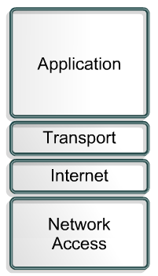
History and Future of TCP/IP
The U.S. Department of Defense (DoD) created the TCP/IP reference model because it wanted a network that could survive any conditions.
Some of the layers in the TCP/IP model have the same name as layers in the OSI model.

Slide 7
Application Layer
Handles high-level protocols, issues of representation, encoding, and dialog control.
The TCP/IP protocol suite combines all application related issues into one layer and ensures this data is properly packaged before passing it on to the next layer.

Slide 8
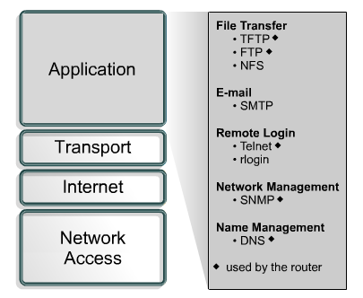
Application Layer Examples

Slide 9
Transport Layer
Five basic services:
Segmenting upper-layer application data
Establishing end-to-end operations
Sending segments from one end host to another end host
Ensuring data reliability
Providing flow control

Slide 10
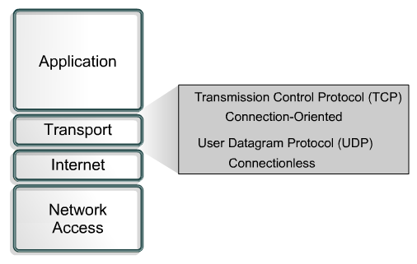
Transport Layer Protocols

Slide 11
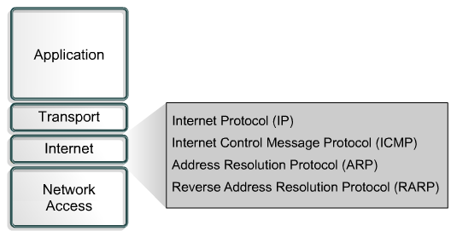
Internet Layer
The purpose of the Internet layer is to send packets from a network node and have them arrive at the destination node independent of the path taken.

Slide 12
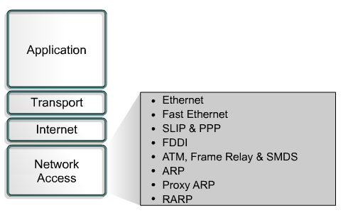
Network Access Layer
The network access layer is concerned with all of the issues that an IP packet requires to actually make a physical link to the network media.
It includes the LAN and WAN technology details, and all the details contained in the OSI physical and data link layers.

Slide 13
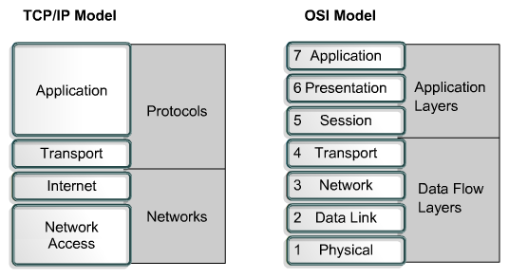
Comparing the OSI Model and TCP/IP Model

Slide 14
Similarities of the OSI and TCP/IP Models
Both have layers.
Both have application layers, though they include very different services.
Both have comparable transport and network layers.
Packet-switched, not circuit-switched, technology is assumed.
Networking professionals need to know both models.

Slide 15
Differences of the OSI and TCP/IP Models
TCP/IP combines the presentation and session layer into its application layer.
TCP/IP combines the OSI data link and physical layers into one layer.
TCP/IP appears simpler because it has fewer layers.
TCP/IP transport layer using UDP does not always guarantee reliable delivery of packets as the transport layer in the OSI model does.

Slide 16
Internet Architecture
Two computers, anywhere in the world, following certain hardware, software, protocol specifications, can communicate, reliably even when not directly connected.
LANs are no longer scalable beyond a certain number of stations or geographic separation.

Slide 17
Internet Addresses

Slide 18
Planning IP Addressing
Addressing Guidelines
Assigning Network IDs
Assigning Host IDs

Slide 19

Addressing Guidelines
IP Address are by TCP/IP v-4.0
There are 5 Classes of IP Addressing
Class A, B & C are used for General Networking
Class D is for Multicasting Purpose
Class E is for IETF’s own use
IP Address has two Part:-
1. Network
2. Host

Slide 20
Addressing Guidelines
The First Number in the Network ID Cannot Be 127
The Host ID Cannot Be All 255s
The Host ID Cannot Be All Zeros
IP Addresses are Represented in Dotted Decimal Format
Dotted Decimal is by Four Octet (w.x.y.z)
IP v-4.0 is 32 bit Addressing Format

Slide 21
Addressing Guidelines
1st Octet (w) is for the Identification of Class
Each Octet have 8 bit value
The Values are from 0-255 in each octet
The Subnet Mask is used to Identify the Network Part
The Network ID should be Constant for a Particular Network
The Host ID Must Be Unique to the Local Network ID

Slide 22







Assigning Network IDs
1
2
Router
3
10.0.0.0
192.168.2.0
172.16.0.0

Slide 23
Assigning Host IDs
1
10.0.0.1
172.16. 0.1
2
Router
10.0.0.10
172.16. 0.10
192.168.2.1
192.168.2.10
10.0.0.11
172.16. 0.11
192.168.2.11
10.0.0.12
172.16. 0.12
3
10.0.0.0
192.168.2.0
172.16.0.0

Slide 24
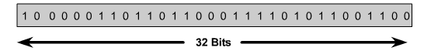

IP Addressing
An IP address is a 32-bit sequence of 1s and 0s.
To make the IP address easier to use, the address is usually written as four decimal numbers separated by periods.
This way of writing the address is called the dotted decimal format.

Slide 25

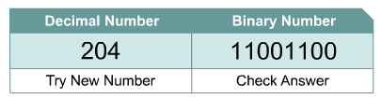
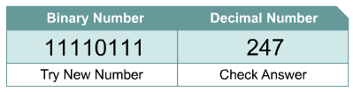
Decimal and Binary Conversion

Slide 26
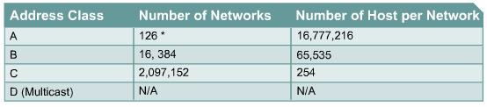
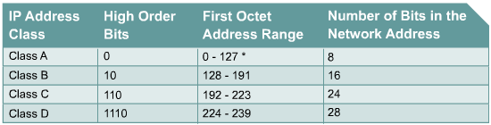

IPv4 Addressing

Slide 27
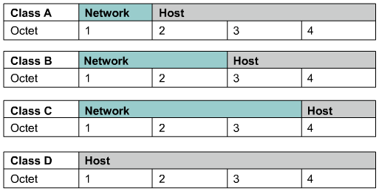
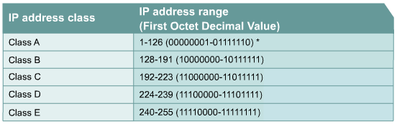

Class A, B, C, D, and E IP Addresses

Slide 28
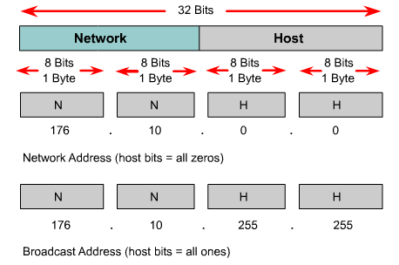
Reserved IP Addresses
Certain host addresses are reserved and cannot be assigned to devices on a network.
An IP address that has binary 0s in all host bit positions is reserved for the network address.
An IP address that has binary 1s in all host bit positions is reserved for the network address.

Slide 29
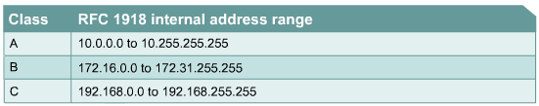
Public and Private IP Addresses
No two machines that connect to a public network can have the same IP address because public IP addresses are global and standardized.
However, private networks that are not connected to the Internet may use any host addresses, as long as each host within the private network is unique.
RFC 1918 sets aside three blocks of IP addresses for private, internal use.
Connecting a network using private addresses to the Internet requires translation of the private addresses to public addresses using Network Address Translation (NAT).

Slide 30
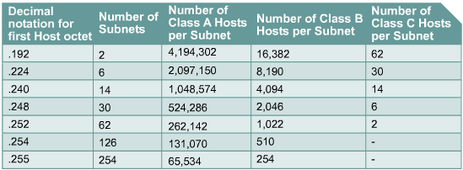
Introduction to Subnetting
To create a subnet address, a network administrator borrows bits from the host field and designates them as the subnet field.

Slide 31
Subnetting a Network
Subnets
Subnet Masks
Determining Local and Remote Hosts

Slide 32

Analogy
Dividing the barrel of apples into small barrels or baskets does not give us any more apples…
100 Apples

Slide 33
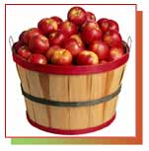
Analogy
10 barrels x 10 apples = 100 apples
10
10
10
100 Apples (10 * 10)
10
10
10
10
10
10
It is the same as taking a barrel of 100 apples and dividing it into 10 barrels of 10 apples each.
10

Slide 34
Analogy
100 – 2 apples = 98 Usable Apples
Before subnetting:
In any network (or subnet) we can not use all the IP addresses for host addresses.
We lose two addresses for every network or subnet.
Network Address - One address is reserved to that of the network.
Broadcast Address – One address is reserved to address all hosts in that network or subnet.
98 Apples (100 – 2)

Slide 35
10 barrels x 8 apples = 80 apples
8
8
8
(less 2)
(less 2)
(less 2)
80 Apples 10 * (10 - 2)
8
8
8
(less 2)
(less 2)
(less 2)
8
8
8
(less 2)
(less 2)
(less 2)
In subnetting we will see that we continue to lose two apples per subnet, one for the address and one for the broadcast.
8

Slide 36
10 barrels x 8 apples = 80 apples
X
---
8
8
8
(less 2)
(less 2)
(less 2)
64 Apples 8 * (10 - 2)
8
8
8
(less 2)
(less 2)
(less 2)
8
8
8
(less 2)
(less 2)
(less 2)
We “might” also lose the last basket of apples, subnet, as it contains the broadcast address for the entire network.
In older networks, we “might” also lost the first basket, subnet, as it contained the address of the entire network, but this is usually no longer the case.
X
---
8

Slide 37
Subnets
Subnet 1
Subnet 2
1
2
Hub
Hub

Slide 38
Subnet Masks
IP
Address
10.50.100.
200
Subnet
Mask
255.255.255.
0
Network
ID
10.50.100.
0

Slide 39
Determining Local and Remote Hosts
Example 1
1
2
A
Local Hosts
D
192.168.1.100
B
E
192.168.2.100
Router
C
F
Subnet
Mask
255.255.0.0

Slide 40
Classless Inter-Domain Routing (CIDR)
Limitations of Classful IP Addressing
Defining CIDR
Sub netting
Super netting
VLSM

Slide 41

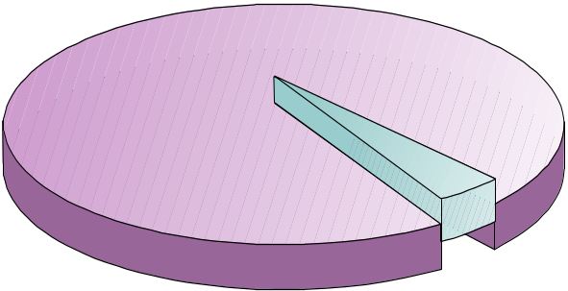
Limitations of Classful IP Addressing
Wastes IP Addresses
Class B
Network ID
Host ID
255
255
0
0
w
x
y
z
Network of 2000 Computers
Assigned 65,534 IP Addresses
63,534
Wasted
2000
Allocated

Slide 42
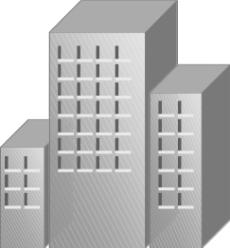

Limitations of Classful IP Addressing
Adds Multiple Entries to Routing Tables
Class C
Network ID
Host ID
255
255
255
0
w
x
y
z
Company Network IDs
192.168.1.0
Internet
192.168.2.0
192.168.3.0
Portion of Internet Routing Tables
192.168.1.0 255.255.255.0 192.168.1.1
192.168.2.0 255.255.255.0 192.168.2.1
192.168.3.0 255.255.255.0 192.168.3.1
192.168.4.0 255.255.255.0 192.168.4.1
192.168.5.0 255.255.255.0 192.168.5.1
192.168.6.0 255.255.255.0 192.168.6.1
192.168.7.0 255.255.255.0 192.168.7.1
192.168.8.0 255.255.255.0 192.168.8.1
192.168.4.0
192.168.5.0
192.168.6.0
192.168.7.0
192.168.8.0

Slide 43
Defining CIDR
IP Address in Dotted Decimal Notation
w
x
y
z
10.217.123.7
4 Values
Network ID
Host ID
32 Values
IP Address in Binary Notation
00001010 11011001 01111011 00000111

Slide 44
Binary IP Addresses
Converting to Binary Format
Converting to Binary Format Using a Calculator

Slide 45
Converting to Binary Format
Binary Notation (Base 2)
2⁷
2⁶
2⁵
2⁴
2³
2²
2¹
2⁰
8 Bits
128
64
32
16
8
4
2
1
1
1
1
1
1
1
1
1
1
1
0
1
1
0
0
1
1*128
1*64
0*32
1*16
1*8
0*4
0*2
1*1
128
64
32
16
8
4
2
1
128
64
0
16
8
0
0
1
Decimal Value 255
Example
217

Slide 46
Binary Subnet Masks
Subnet Mask Bits
CIDR Notation
Calculating the Network ID

Slide 47
Subnet Mask Bits
Binary Representation
Decimal Representation
11111111
255
11111110
254
11111100
252
11111000
248
11110000
240
11100000
224
11000000
192
10000000
128
00000000
0

Slide 48


Subnet Mask Table
No. of Bit 128 64 32 16 8 4 2 1 Subnet
Bit Value 0 0 0 0 0 0 0 0 Value
1 128 1 0 0 0 0 0 0 0 128
2 64 1 1 0 0 0 0 0 0 128+64=192
3 32 1 1 1 0 0 0 0 0 128+64+32=224
4 16 1 1 1 1 0 0 0 0 128+64+32+16=240
5 8 1 1 1 1 1 0 0 0 128+64+32+16+8=248
6 4 1 1 1 1 1 1 0 0 128+64+32+16+8+4=252
7 2 1 1 1 1 1 1 1 0 128+64+32+16+8+4+2=254
8 1 1 1 1 1 1 1 1 1 128+64+32+16+8+4+2+1=255

Slide 49
CIDR Notation
IP
Address
10 . 217 . 123 . 7
00001010 11011001 01111011 00000111
Subnet
Mask
255 . 255 . 240 . 0
11111111 11111111 11110000 00000000
Number of Subnet
Mask Bits (ones)
8 + 8 + 4 + 0 = 20
IP Address in
CIDR Notation
10.217.123.7/20

Slide 50
Calculating the Network ID
IP Address in CIDR Notation: 10.217.123.7/20
IP
Address
10 . 217 . 123 . 7
00001010 11011001 01111011 00000111
Subnet
Mask
255 . 255 . 240 . 0
11111111 11111111 11110000 00000000
Network
ID
00001010 11011001 01110000 00000000
Network ID in
CIDR Notation
10.217.112.0/20

Slide 51
Determining Subnets
Example
Split into 4 Network the IP Address given below:-
200.100.1.0
255.255.255.0
Formula:- 2^{n} –2 > No. of Network/No. of Site/Subnets
2¹-2 > 0 N/W Bit = 24+3
2²-2 > 2 Host Bit = 5
2³-2 > 6
Subnet Mask – 255.255.255.224
IP Address;- 200.100.1.111 00000 or 256
001 = 32 -224
010 = 64 32
011 = 96
100 = 128
110 = 160
111 = 224 (Not Valid)

Slide 52
Available Host IDs
Subnet Mask
Network ID
Host ID
1
1
1
1
1
1
1
1
1
1
1
1
1
1
0
0
0
0
0
0
0
0
0
0
0
0
0
0
N
Number of Host IDs : 2^{n} - 2

Slide 53
Subnetting Use
After Subnetting
Routing Table for Router B
220.78.168.0
220.78.168.0 255.255.255.0 220.78.168.1
220.78.168.64
220.78.168.128
220.78.168.192
220.78.169.0
Router
A
220.78.169.64
Router B
220.78.169.128
220.78.169.192
220.78.170.0
220.78.170.64

Slide 54
Supernetting
Routing Table for Router B
After Supernetting:
220.78.168.0 255.255.255.0 220.78.168.1
220.78.168.0
Router A
Router B

Slide 55
VLSM (Variable Length Subnet Mask)
INT.COM
DELHI
500 CLIENTS
MUMBAI
2000 CLIENTS
CHENNAI
50 CLIENTS
HYD
5
DEL- 2^{9 –} 2 = 512
Subnet Mask- 255.255.11111111.00000000
255.255.254.0

Slide 56
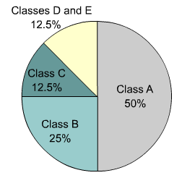
IPv4 versus IPv6
IP version 6 (IPv6) has been defined and developed.
IPv6 uses 128 bits rather than the 32 bits currently used in IPv4.
IPv6 uses hexadecimal numbers to represent the 128 bits.
IPv4

Slide 57
Obtaining an IP Address

Slide 58
Obtaining an Internet Address
Static addressing
  Each individual device must be configured with an IP address.
Dynamic addressing
  Reverse Address Resolution Protocol (RARP)
  Bootstrap Protocol (BOOTP)
  Dynamic Host Configuration Protocol (DHCP)
  DHCP initialization sequence
  Function of the Address Resolution Protocol
  ARP operation within a subnet

Slide 59
Assigning TCP/IP Addresses
Static IP Addressing
Automatic IP Addressing
Viewing TCP/IP Configuration
Viewing TCP/IP Configuration Using Ipconfig

Slide 60
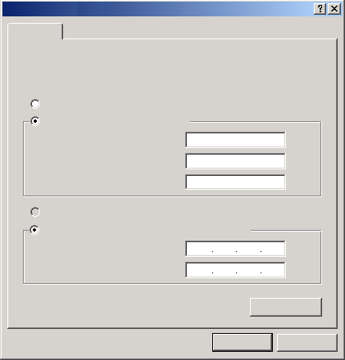
Static IP Addressing
Internet Protocol (TCP/IP) Properties
General
You can get IP settings assigned automatically if your network supports this capability. Otherwise, you need to ask your network administrator for the appropriate IP settings.
Obtain an IP address automatically
Use the following IP address:
IP address:
192 . 168 . 1 . 200
Subnet mask :
255 . 255 . 255. 0
Default gateway:
192. 168 . 1 . 1
Obtain DNS server address automatically
Use the following DNS server addresses:
Preferred DNS server:
Alternate DNS server:
Advanced...
OK
Cancel

Slide 61
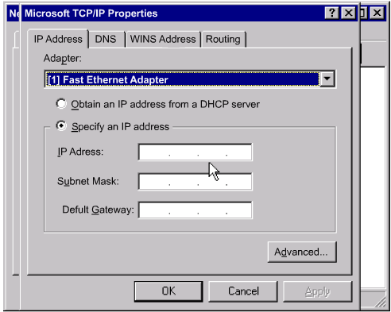
Static Assignment of IP Addresses
Each individual device must be configured with an IP address.

Slide 62
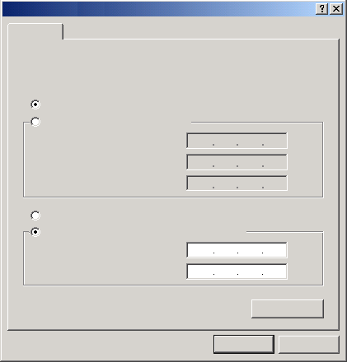
Automatic IP Addressing
Internet Protocol (TCP/IP) Properties
General
You can get IP settings assigned automatically if your network supports this capability. Otherwise, you need to ask your network administrator for the appropriate IP settings.
Obtain an IP address automatically
Use the following IP address:
IP address:
Subnet mask :
Default gateway:
Obtain DNS server address automatically
Use the following DNS server addresses:
Preferred DNS server:
Alternate DNS server:
Advanced...
OK
Cancel

Slide 63
Viewing TCP/IP Configuration
Internet Protocol (TCP/IP) Properties
General
You can get IP settings assigned automatically if your network supports this capability. Otherwise, you need to ask your network administrator for the appropriate IP settings.
Obtain an IP address automatically
Use the following IP address:
IP address:
192 . 168 . 1 . 200
Subnet mask :
255 . 255 . 255. 0
Default gateway:
192. 168 . 1 . 1
Obtain DNS server address automatically
Use the following DNS server addresses:
Preferred DNS server:
Alternate DNS server:
Advanced...
OK
Cancel

Slide 64

Viewing TCP/IP Configuration Using Ipconfig
Command Prompt
Microsoft Windows 2000 [version 5.00.2195]
(C) Copyright 1985-1999 Microsoft Corp.
C:\>ipconfig
Windows 2000 IP Configuration
Ethernet adapter Local Area Connection:
Connection-specific DNS Suffix . :
IP Address. . . . . . . . . . . . : 192.168.1.200
Subnet Mask . . . . . . . . . . . : 255.255.255.0
Default Gateway . . . . . . . . . : 192.168.1.1
C:\>_

Slide 65
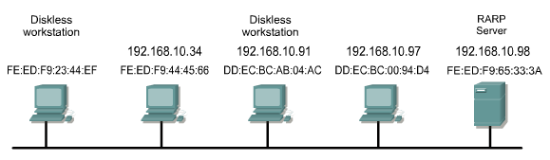
Reverse Address Resolution Protocol (RARP)
MAC HEADER | IP HEADER | RARP REQUEST MESSAGE
Destination FF-FF-FF-FF-FF-FF Source FE:ED:FD:23:44:EF | Destination 255.255.255.255 Source ???????? | What is my IP address?

Slide 66
BOOTP IP
The Bootstrap Protocol (BOOTP) operates in a client/server environment and only requires a single packet exchange to obtain IP information.
BOOTP packets can include the IP address, as well as the address of a router, the address of a server, and vendor-specific information.

Slide 67
Dynamic Host Configuration Protocol
Allows a host to obtain an IP address using a defined range of IP addresses on a DHCP server.
As hosts come online, contact the DHCP server, and request an address.

Slide 68
Problems in Address Resolution
In TCP/IP communications, a datagram on a local-area network must contain both a destination MAC address and a destination IP address.
There needs to be a way to automatically map IP to MAC addresses.
The TCP/IP suite has a protocol, called Address Resolution Protocol (ARP), which can automatically obtain MAC addresses for local transmission.
TCP/IP has a variation on ARP called Proxy ARP that will provide the MAC address of an intermediate device for transmission outside the LAN to another network segment.

Slide 69
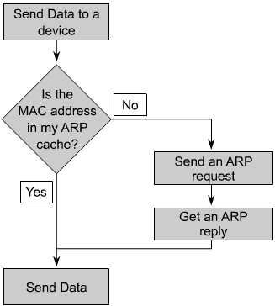
Address Resolution Protocol (ARP)
Each device on a network maintains its own ARP table.
A device that requires an IP and MAC address pair broadcasts an ARP request.
If one of the local devices matches the IP address of the request, it sends back an ARP reply that contains its IP-MAC pair.
If the request is for a different IP network, a router performs a proxy ARP.
The router sends an ARP response with the MAC address of the interface on which the request was received, to the requesting host.

Slide 70
Your Turn!
Problem 1
Host IP Address: 10.10.10.193
Network Mask: 255.255.0.0
Subnet Mask: 255.255.255.0
Problem 2
Host IP Address: 10.10.10.193
Network Mask: 255.255.255.0
Subnet Mask: 255.255.255.240
Problem 3
Host IP Address: 10.10.10.193
Network Mask: 255.255.255.0
Subnet Mask: 255.255.255.252

Slide 71
Review
Classless Inter-Domain Routing (CIDR )
Binary IP Addresses
Binary Subnet Masks
IP Address Allocation Using CIDR
Subnetting
Supernetting
Variable Length of Subnet mask

Slide 72
Review
Classful IP Addressing
Subnetting a Network
Planning IP Addressing
Assigning TCP/IP Addresses

Slide 73
Practice Session

